Slide 1

very A ^ short introduction to the Battery Programming Box Boot Camp 2022

Slide 2
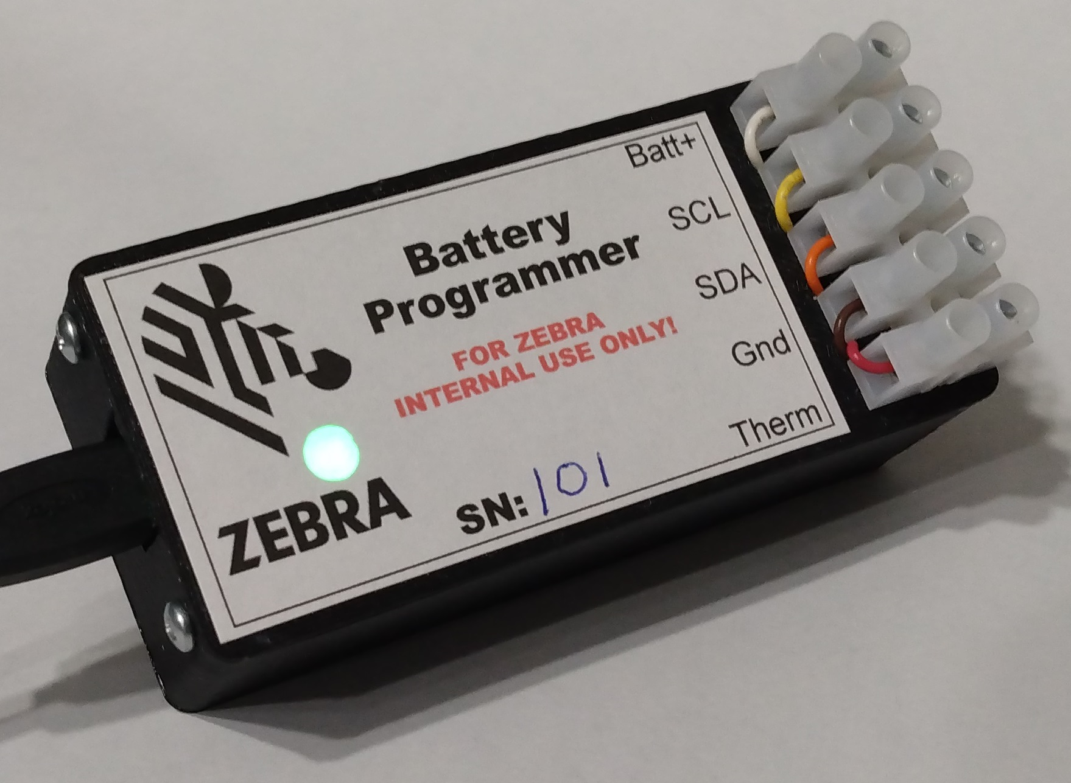
Device Overview
Small device used to access battery ICs
Reads/Writes EEPROM, Auth IC, and Gas Gauge
USB interface, appears as a serial port and 2MB Flash drive
Simple command line interface
Drag & drop files to/from the drive
Supports most Zebra terminal battery types
Status LED for connection/battery status
Terminal strip for battery socket connections
Device parts cost is ~$50 each
Zebra Confidential: For Internal Use Only

Slide 3
Batteries Supported
MPA2 Smart Batteries (MC33 legacy)
Pollux batts (TC70)
PP+ Batts (TC70X, TC51, TC8000, MC18, etc.)
Value tier (TC21, MC22, etc.)
PP+ V2 (New GG) (Jaws, etc.)
Hardware support for BLE battery
Simulate terminal power modes (on, off, suspended)
Simulate battery in & out of terminal
Hardware can support Zebra printer 2 cell packs
Zebra Confidential: For Internal Use Only

Slide 4
Capabilities
Read\write EEPROM/Auth IC hex file data to/from internal 2MB drive
Validate battery data to check for errors
Authenticate the Auth IC
Display battery voltage and thermistor resistance
Display battery EEPROM/Auth IC data in human readable form
Part number, revision, JEITA data, etc.
Display gas gauge data in human readable form
Cycle count, accumulated charge, time since first use, status registers, etc.
Update/replace EEPROM/Auth IC hex data
Update Gas Gauge data & firmware
Zebra Confidential: For Internal Use Only

Slide 5
Uses
Engineering/Testing
Creating batteries with know errors to check terminal/toaster firmware
Updating battery/gas gauge data
Jaws “0%” batts that had bad GG data & old firmware
Jaws 1.5X batts shipped before correct hex/GG files were ready
ECRT
Checking batteries from customers for errors/bad data
Checking number of cycles/SOH of batteries
Service (ZBAT)
Battery programmer software used in c based Python library for ZBAT
Handles battery validation and authentication
Does data extraction: Part#, Cycles, SOH, etc. Saves $ on testing
Corrupted EEPROM repair, saves $ on replacing batteries
Zebra Confidential: For Internal Use Only

Slide 6
Going Forward
Additional battery support
Zebra printer batteries
Battery validation/authentication
Displaying battery data
BLE batteries
Testing BLE beaconing functions
Displaying BLE micro data
Programming BLE micro
Add reading/writing of GG manufacturer blocks hex data
ZBAT Library updates
Add GG update capability
Add V2 PP+ battery support
Zebra Confidential: For Internal Use Only

Slide 7
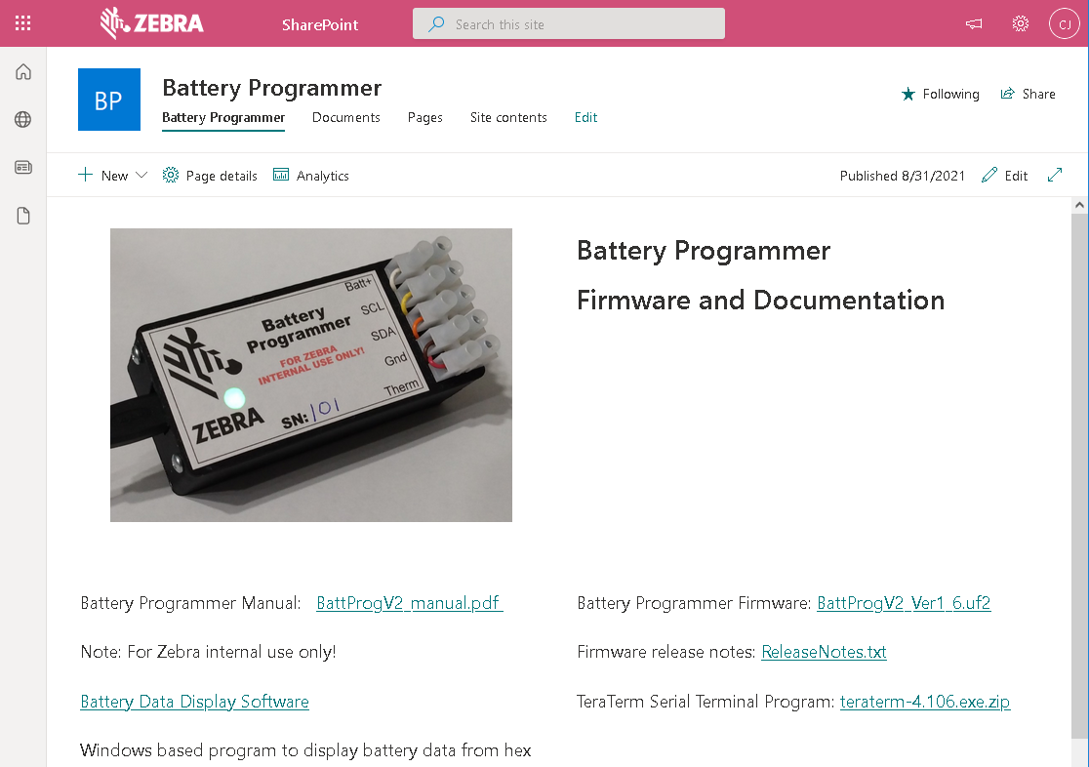
SharePoint Site
https://zebra.sharepoint.com/sites/BatteryProgrammer
PDF Manual
TeraTerm serial terminal install program
Latest Zebra internal and JDM firmware
Release notes
Windows Battery Data Display program
Display battery data from a hex file
Only works with EEPROM/Auth data
Make bad hex file Windows program
Creates errors in battery data for testing
Only works with EEPROM/Auth data
Zebra Confidential: For Internal Use Only

Slide 8
Questions?

